Slide 1
Traditional African Art
Traditional African Art and its Story of Gender
Author: TONY KIMATHI
Reg No: C026-01-0713/2020
4TH YEAR Communication Skills Project
SCHOOL OF COMPUTER SCIENCE
DEDAN KIMATHI UNIVERSITY OF TECHNOLOGY

Slide 2
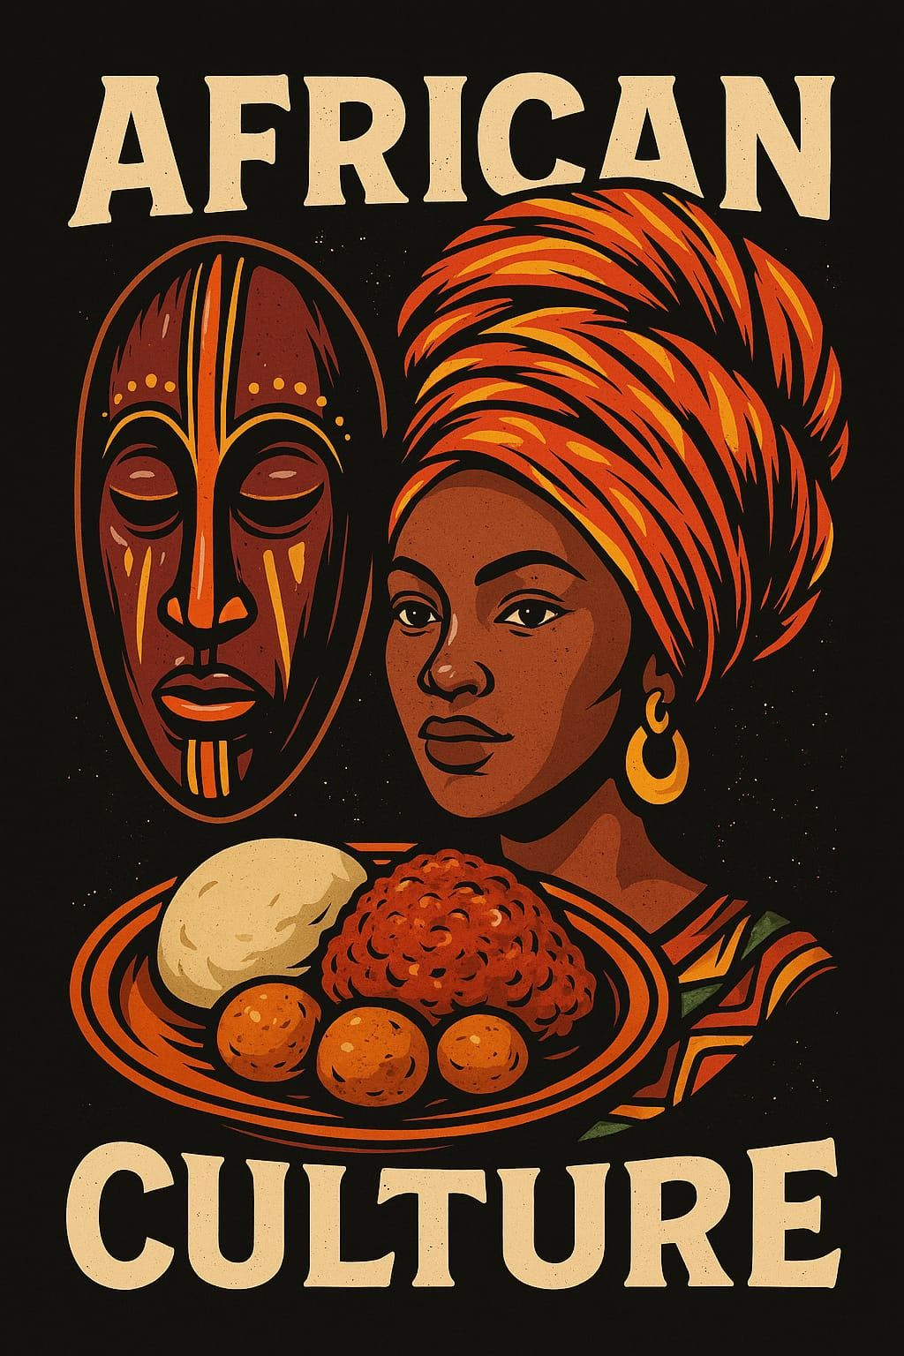
Introduction
Art: More Than Decoration
Art is a living language. It speaks history, identity, and spirit.
This presentation explores African art’s forms and cultural value.
Special focus: How art reflects gender roles in African societies.

Slide 3
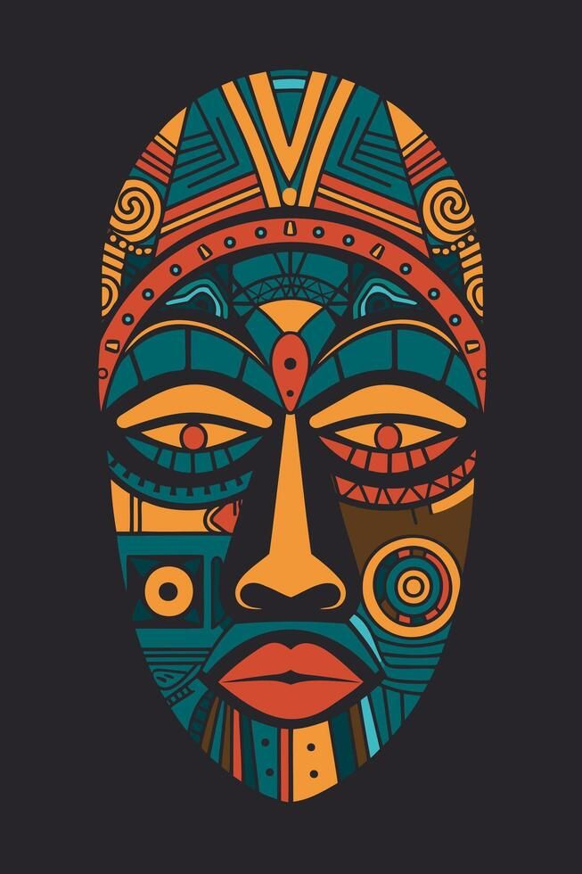
01
The Foundations of Traditional African Art & Its Creation
We Will Cover:
African Art Purpose
Common Themes in TAC
Key materials used
Gender Roles in Art

Slide 4
The Essence of Traditional African Art
Key Materials:
Wood
Metal
Clay
Textiles
Art's Core Purpose:
Functional – Used in daily life (tools, clothing, objects)
Spiritual – Connects with ancestors, deities, and rituals
Communal – Created for and used by the community
Common Themes in Traditional African Art
Ancestry – Honoring lineage and heritage
Fertility – Symbols of life, birth, and growth
Power – Representing leaders, warriors, and authority
Community – Unity, cooperation, and social values
Rites – Initiation, marriage, and coming-of-age ceremonies

Slide 5
Gender Roles in Art Creation & Patronage
Who Made the Art?
Male Artists:
Specialized in sculpture, masks, metalwork
Focused on ritual, power, and leadership symbols
Female Artists:
Created pottery, textiles, beadwork, adornment, murals
Expressed identity, status, communication, and economy
Patronage:
Chiefs, elders, and women’s groups supported artists
They provided resources or commissions for art used in rituals, ceremonies, and community life

Slide 6
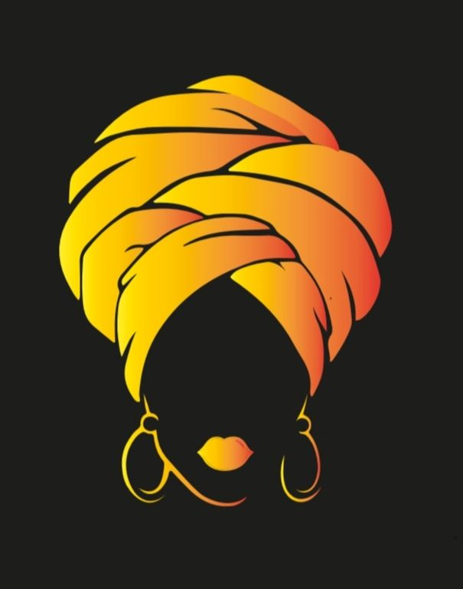
Portrayal of Gender in African Art
Gender in Art: What Does It Show?
Female Figures:
Fertility, Motherhood, Beauty, Wisdom
Empowering or Limiting?
Male Figures:
Warriors, Leaders, Protectors
Gender Fluidity/Ambiguity:
Holistic Power, Challenging Norms
Art as Social Commentary

Slide 7
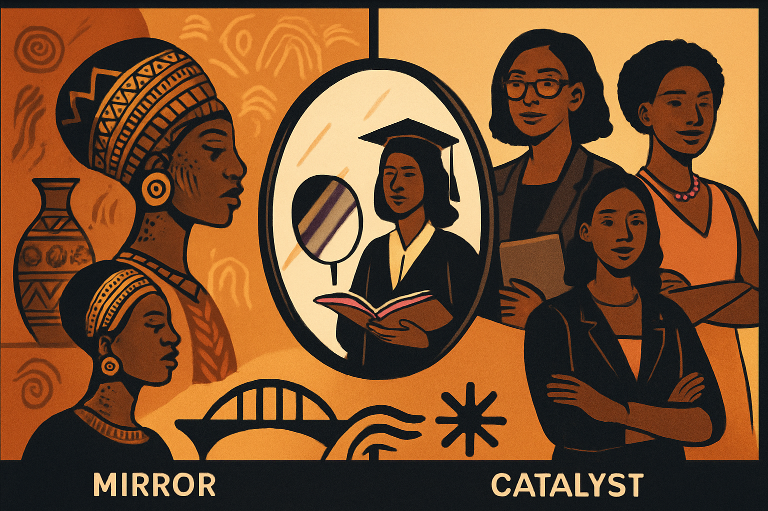
02
Gender Awareness in Modern African Society & Art's Role

Slide 8
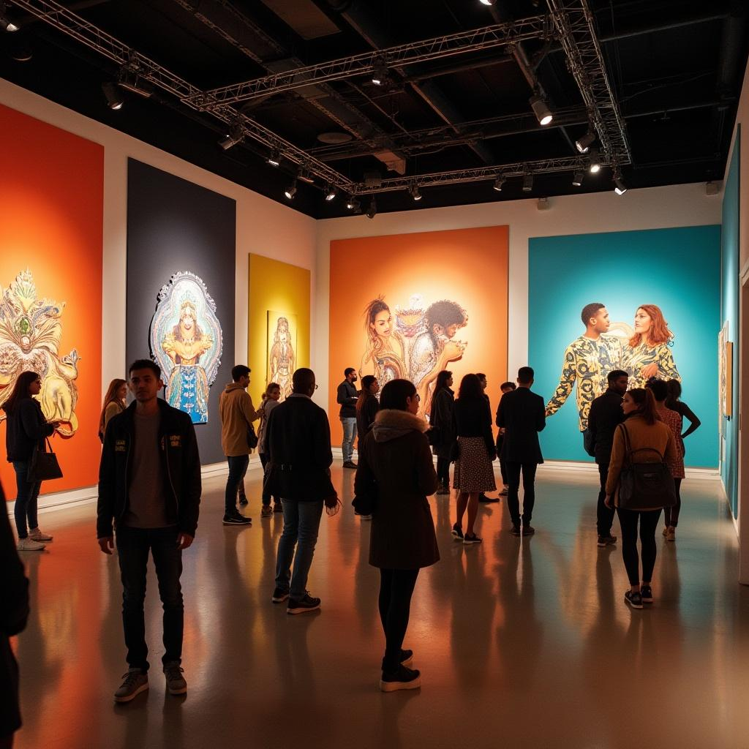
Gender Awareness in Modern African Society & Art's Role
What’s Happening Now:
Today, people are talking more about gender equality and empowering women and girls.
What Role Does Art Play?
Art helps us look back and understand how gender roles were in the past.
Art can inspire women and challenge old ideas that hold people back.
Why This Matters:
Helps us tell a fair, balanced story of both men and women in history.
Promotes gender equality in modern African society.

Slide 9
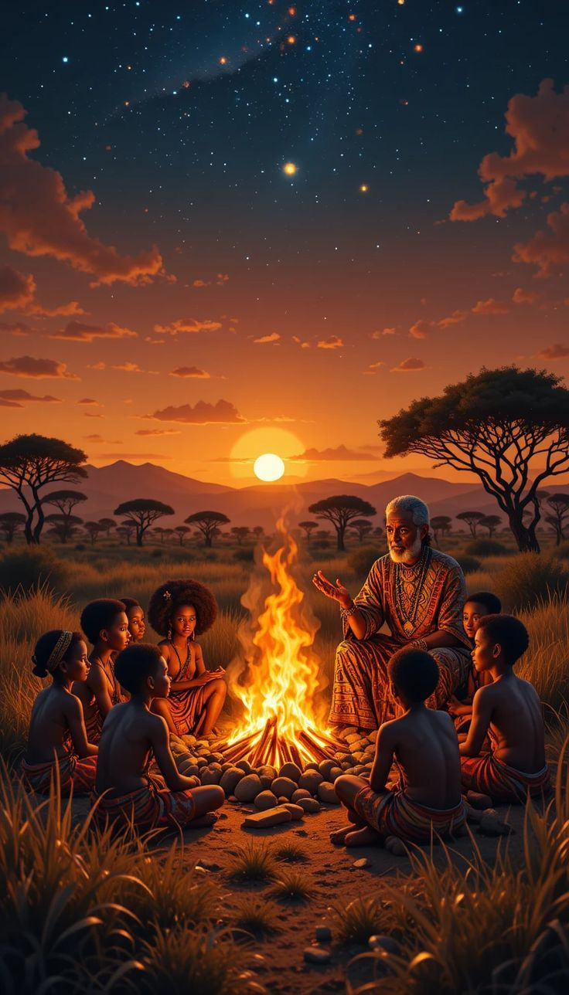
Conclusion
Key Takeaways:
African Art is rich and full of cultural meaning.
It’s closely connected to gender roles and identity.
It helps us understand modern society better.
Always look at art with a gender-aware perspective!

Slide 10
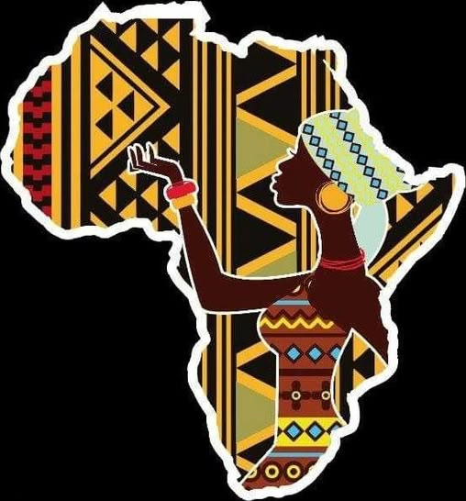
Thank You! Asante Sana!
TONY KIMATHI
C026-01-0713/2020
Questions?
tonykimathi8121@gmail.com
DEDAN KIMATHI UNIVERSITY OF TECHNOLOGY.

